Slide 1
Introduction to MOSFET
Notes:
ELEC 121
January 2004
Introduction to FET's
‹#›

Slide 2
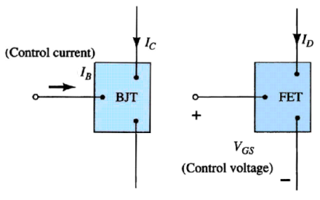
Current Controlled vs Voltage Controlled Devices
January 2004
ELEC 121
‹#›

Slide 3
MOSFET’s

Slide 4
MOSFETs
MOSFETs have characteristics similar to JFETs and additional characteristics that make them very useful.
There are 2 types of MOSFET’s:
Depletion mode MOSFET (D-MOSFET)
Operates in Depletion mode the same way as a JFET when VGS ≤ 0
Operates in Enhancement mode like E-MOSFET when VGS > 0
Enhancement Mode MOSFET (E-MOSFET)
Operates in Enhancement mode
IDSS = 0 until VGS > VT (threshold voltage)
‹#›

Slide 5
MOSFET Handling
MOSFETs are very static sensitive. Because of the very thin SiO₂ layer between the external terminals and the layers of the device, any small electrical discharge can stablish an unwanted conduction.
Protection:
• Always transport in a static sensitive bag
• Always wear a static strap when handling MOSFETS
• Apply voltage limiting devices between the Gate and Source, such as back-to- back Zeners to limit any transient voltage
‹#›

Slide 6
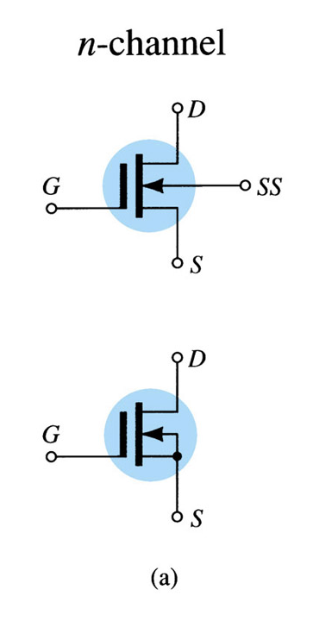
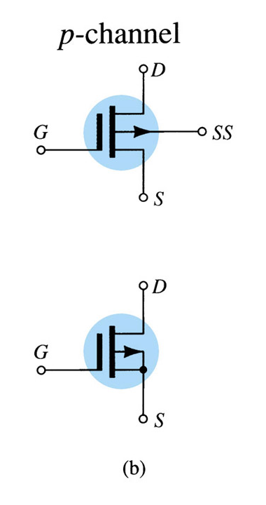
D-MOSFET Symbols
‹#›

Slide 7
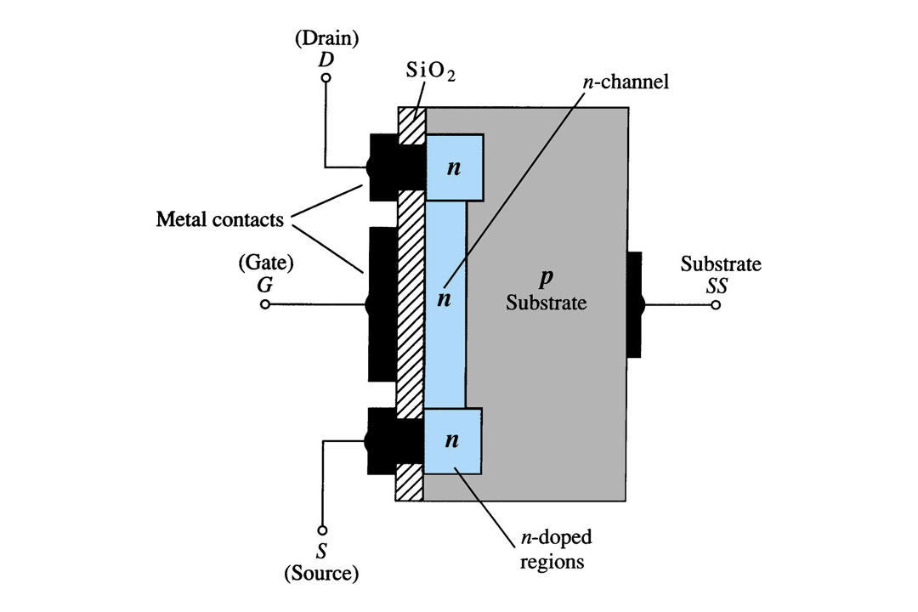
Depletion Mode MOSFET Construction
The Drain (D) and Source (S) leads connect to the to n-doped regions
These N-doped regions are connected via an n-channel
This n-channel is connected to the Gate (G) via a thin insulating layer of SiO₂
The n-doped material lies on a p-doped substrate that may have an additional terminal connection called SS
‹#›

Slide 8
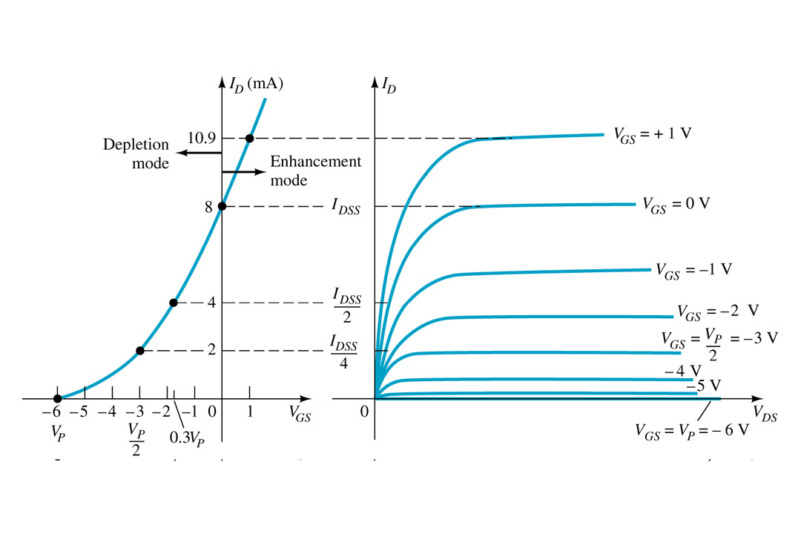
Basic Operation
A D-MOSFET may be biased to operate in two modes:
the Depletion mode or the Enhancement mode
‹#›

Slide 9
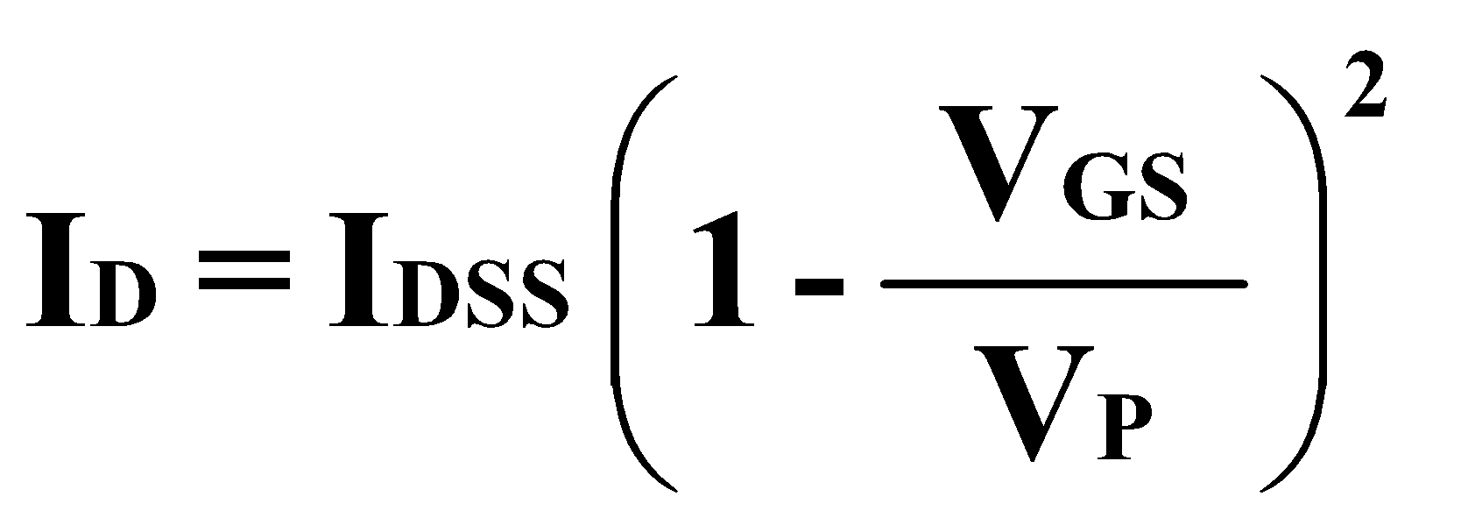
D-MOSFET Depletion Mode Operation
The transfer characteristics are similar to the JFET
In Depletion Mode operation:
When VGS = 0V, ID = IDSS
When VGS < 0V, ID < IDSS
When VGS > 0V, ID > IDSS
The formula used to plot the Transfer Curve, is:
‹#›

Slide 10
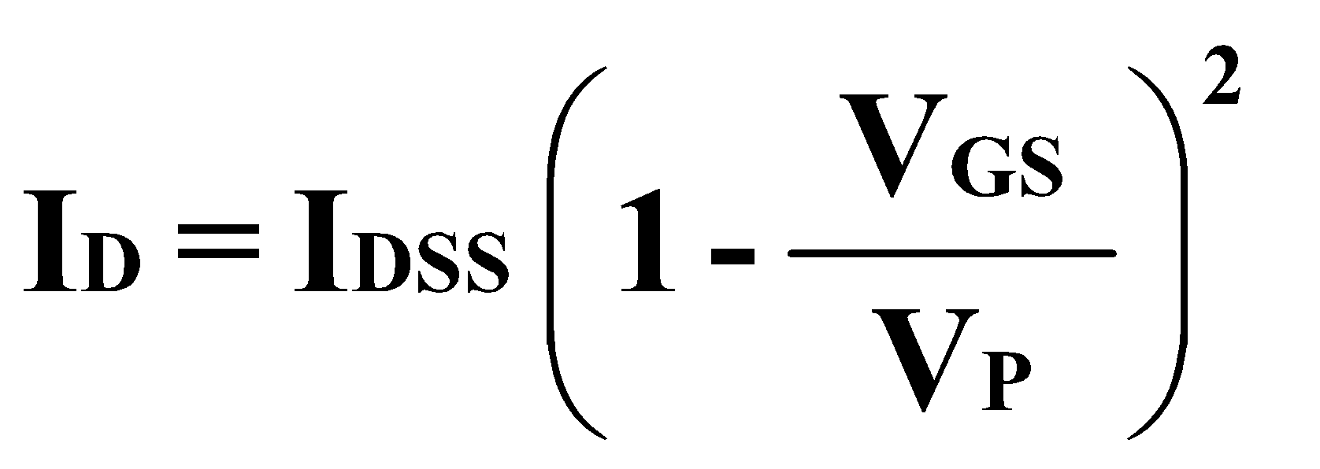
D-MOSFET Enhancement Mode Operation
Enhancement Mode operation
In this mode, the transistor operates with V_{GS} > 0V, and I_{D} increases above I_{DSS}
Shockley’s equation, the formula used to plot the Transfer Curve, still applies but VGS is positive:
‹#›

Slide 11
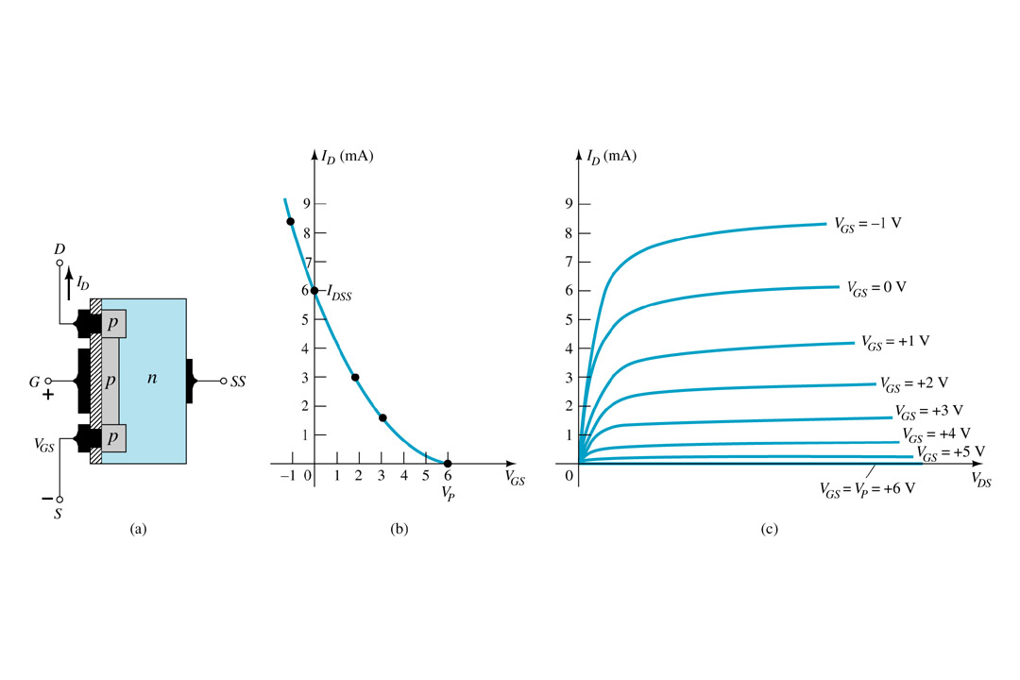
p-Channel Depletion Mode MOSFET
The p-channel Depletion mode MOSFET is similar to the n-channel except that the voltage polarities and current directions are reversed
‹#›

Slide 12
Enhancement Mode MOSFET’s

Slide 13
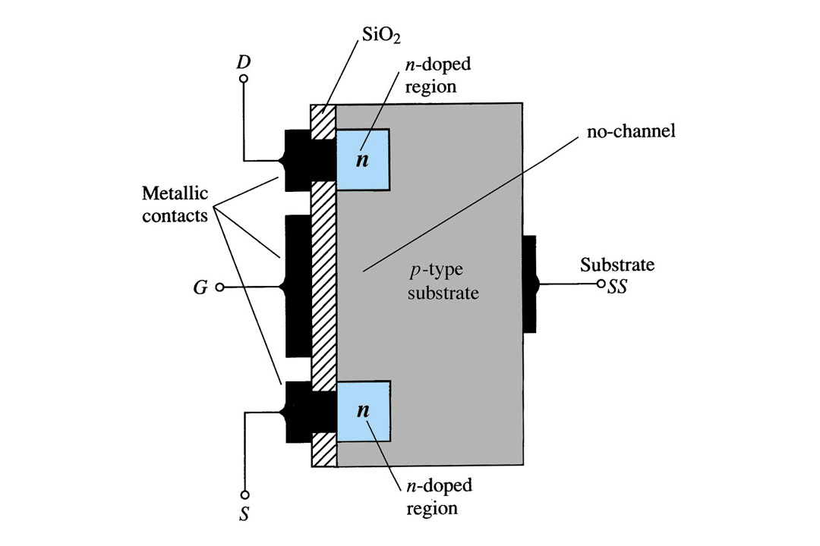
Enhancement Mode MOSFET Construction
The Drain (D) and Source (S) connect to the to n-doped regions
These n-doped regions are not connected via an n-channel without an external voltage
The Gate (G) connects to the p-doped substrate via a thin insulating layer of SiO₂
The n-doped material lies on a p-doped substrate that may have an additional terminal connection called SS
‹#›

Slide 14
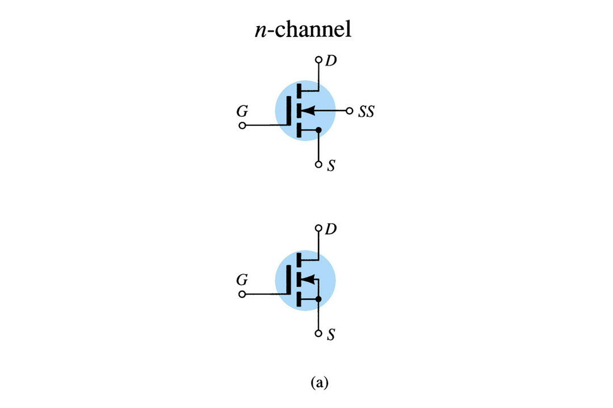
E-MOSFET Symbols
‹#›

Slide 15
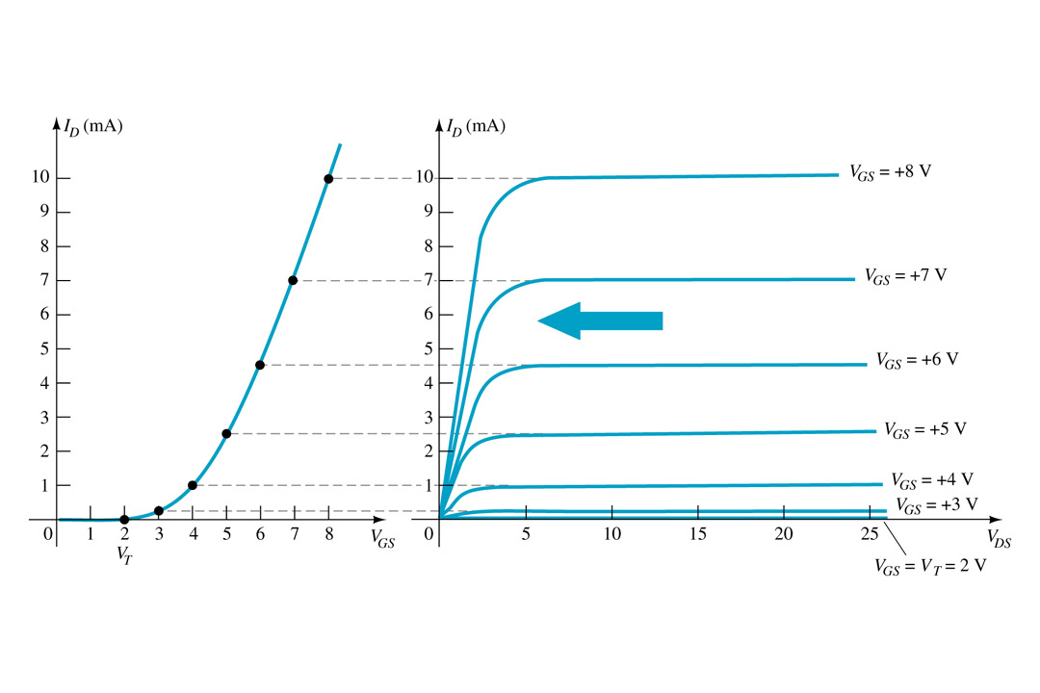
Basic Operation
The Enhancement mode MOSFET only operates in the enhancement mode.
VGS is always positive
IDSS = 0 when VGS < VT
As VGS increases above VT, ID increases
If VGS is kept constant and VDS is increased, then ID saturates (IDSS)
The saturation level, VDSsat is reached.
‹#›

Slide 16
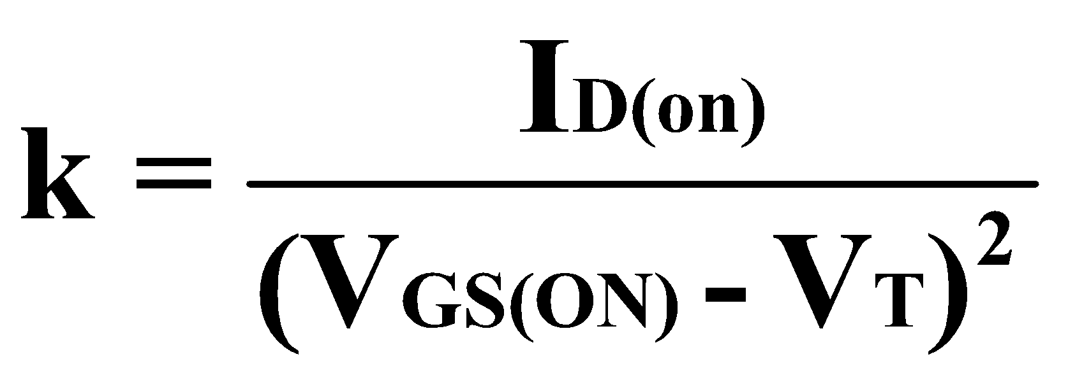
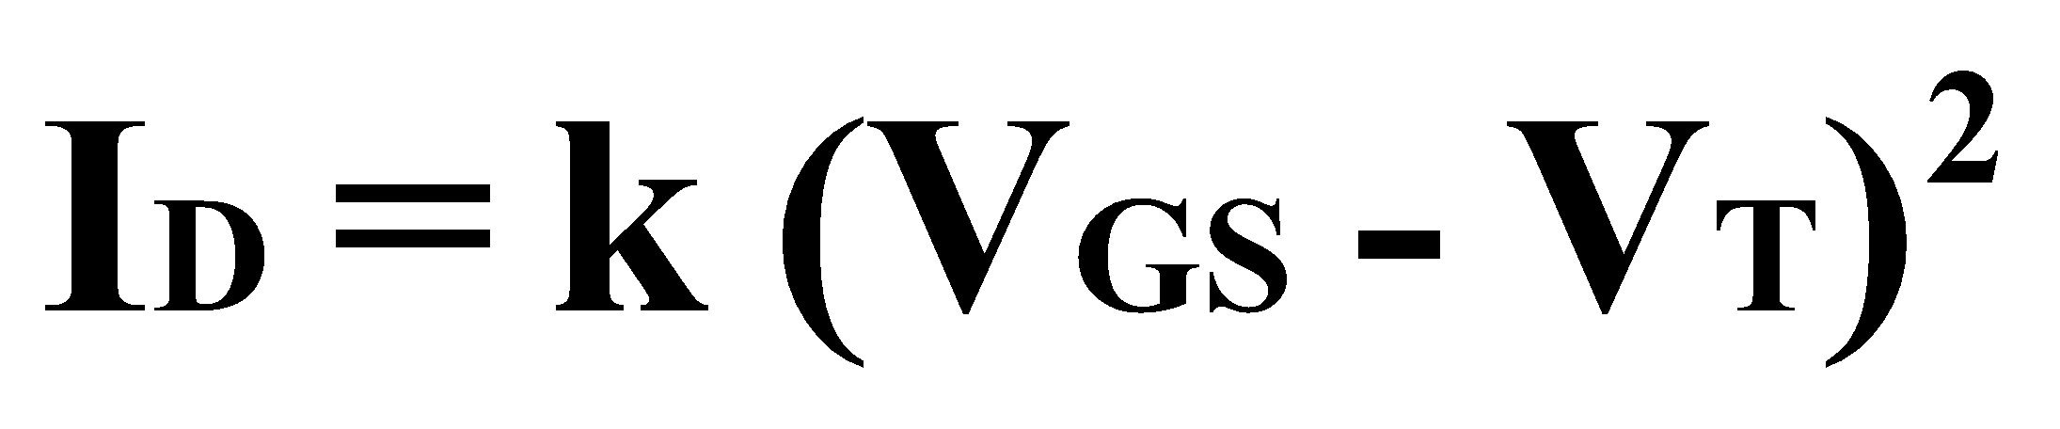
Transfer Curve
To determine ID given VGS:
where VT = threshold voltage or voltage at which the MOSFET turns on.
k = constant found in the specification sheet
‹#›

Slide 17
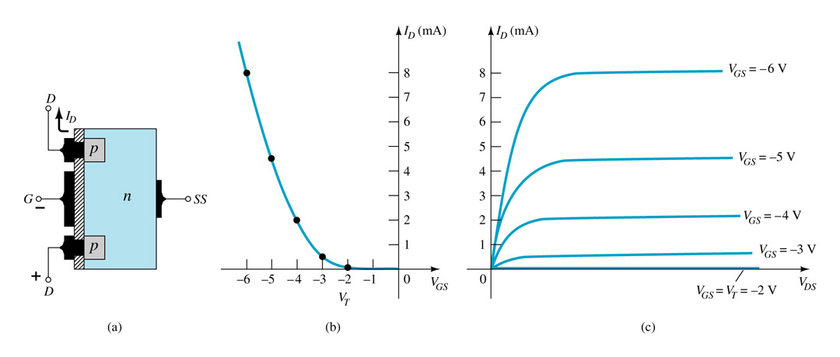
p-Channel Enhancement Mode MOSFETs
The p-channel Enhancement mode MOSFET is similar to the n-channel except that the voltage polarities and current directions are reversed.
‹#›

Slide 18
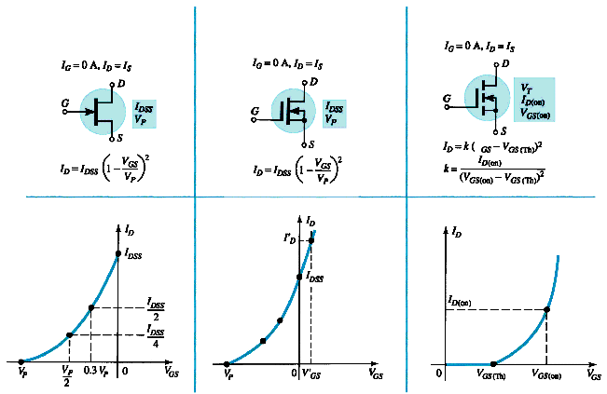
Summary Table
JFET
D-MOSFET
E-MOSFET
‹#›
Notes:
ELEC 121
January 2004
Introduction to FET's
‹#›

